Slide 1
Preferred WHITE BALANCE
Bryan Taylor

Slide 2
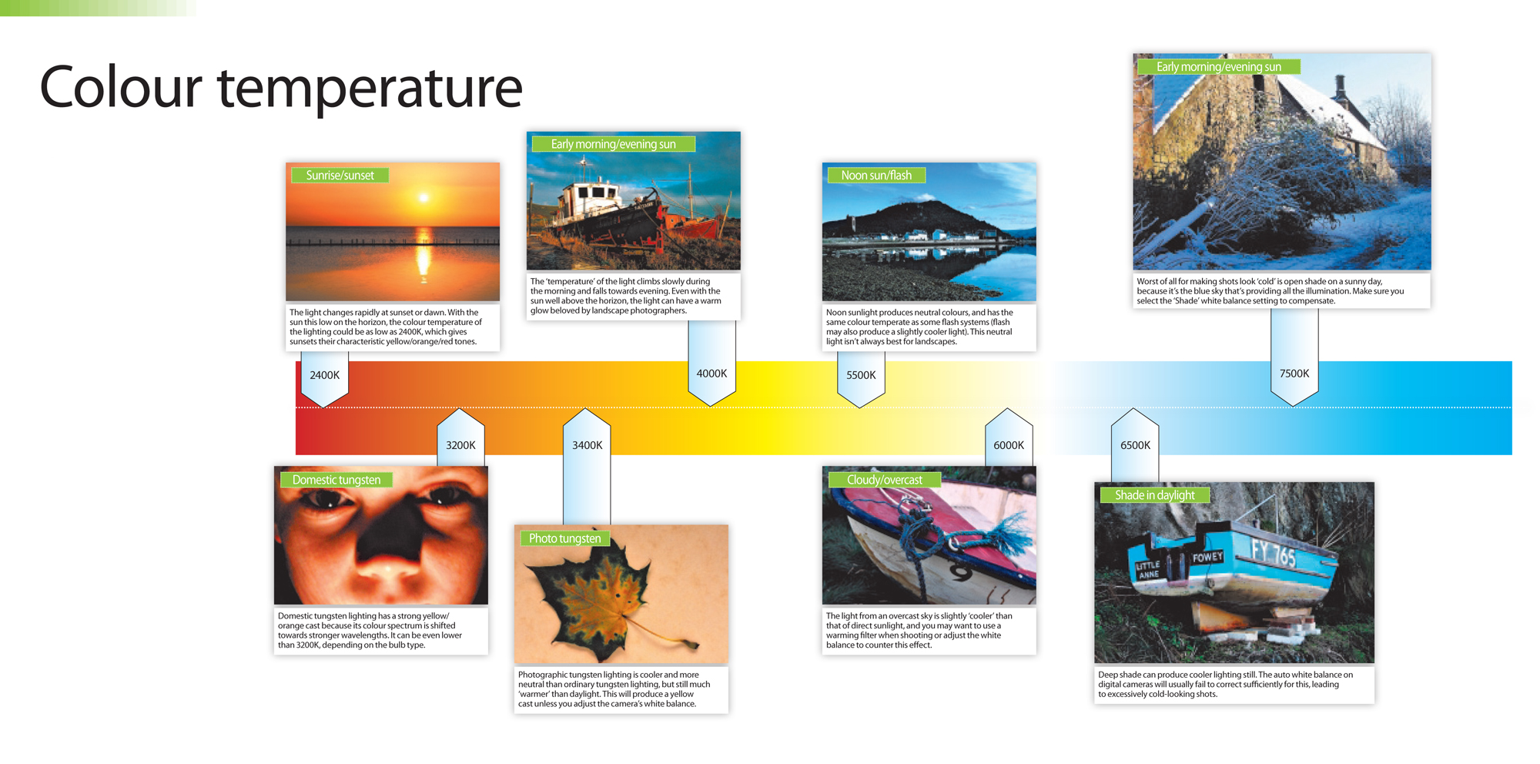

Slide 3
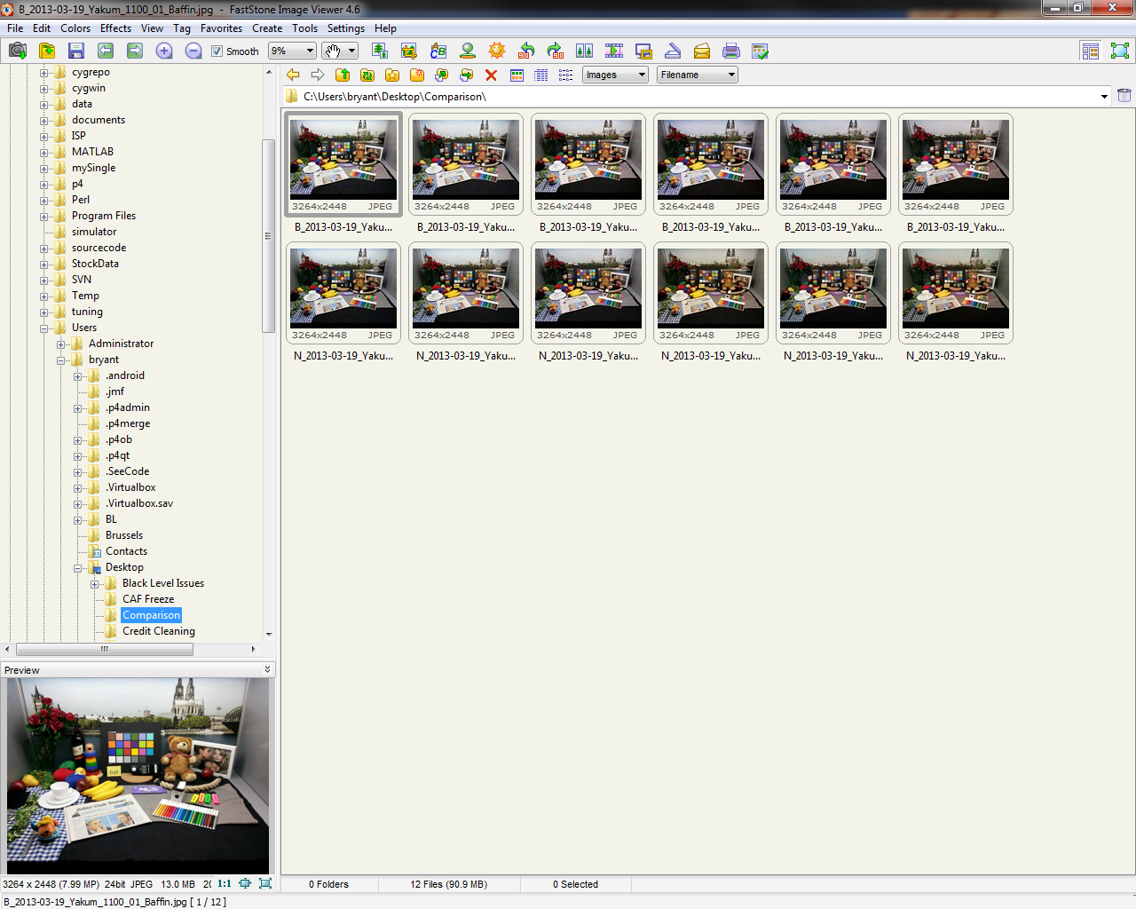
Comparison
HALOGEN
(2400K)
D65
D50
F11 (3800K)
F12 (2800K)
F12 (2800K)
BAFFIN
NOTE2

Slide 4
Tuning Targets
Two types of requirements
D65 Targets only
BRCM method to date
- True colour targets

Slide 5
Samsung Spec
Where,
S = 100x[Max(RGB)-Min(RGB)]/Max(RGB), H = 60x(G-B)/[Max(RGB)-Min(RGB)]
And the spec for AWB is as below.
1. Daylight: S 10 or less
2. Cool White: S 10 or less
3. Horizon: S 20~30, H 10~35
4. Inc. A: S 05~15, H 10~40,
or S 15~20, H 15~35

Slide 6
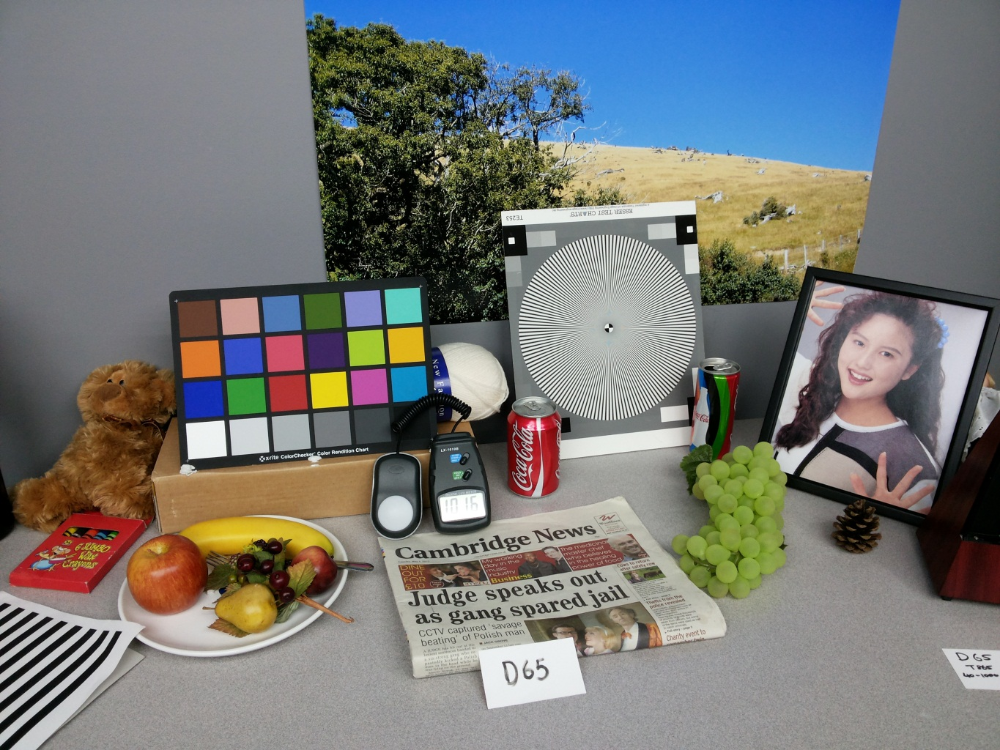
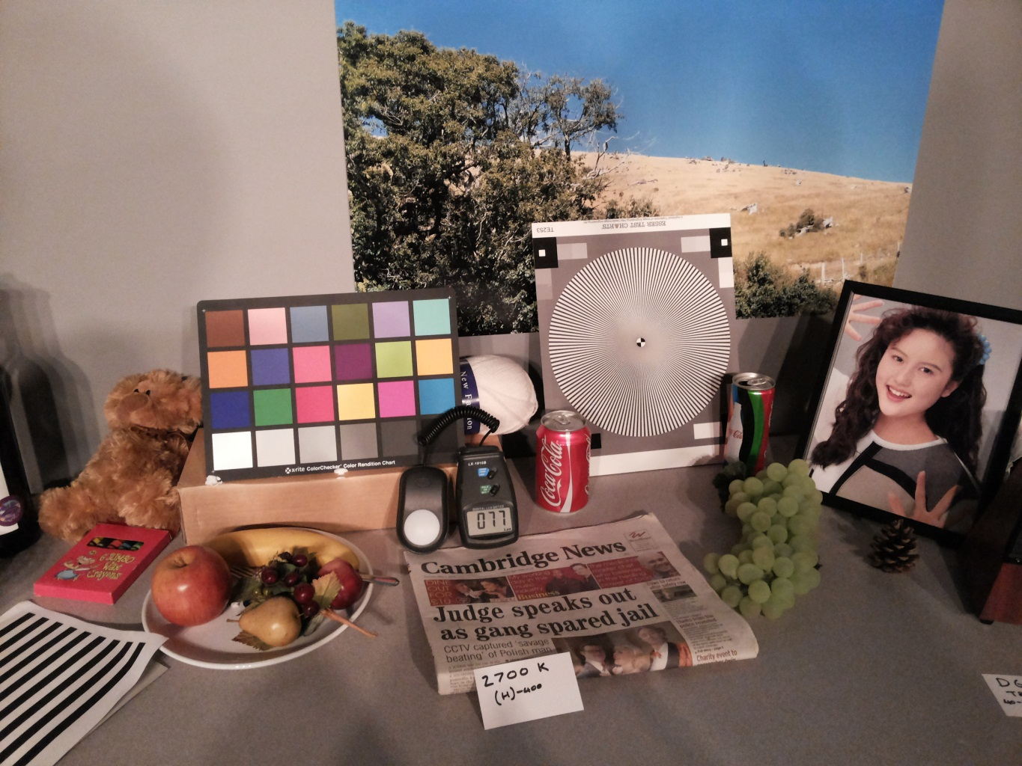
Preferred White Balance (AL logic images)
D65
HORIZON

Slide 7
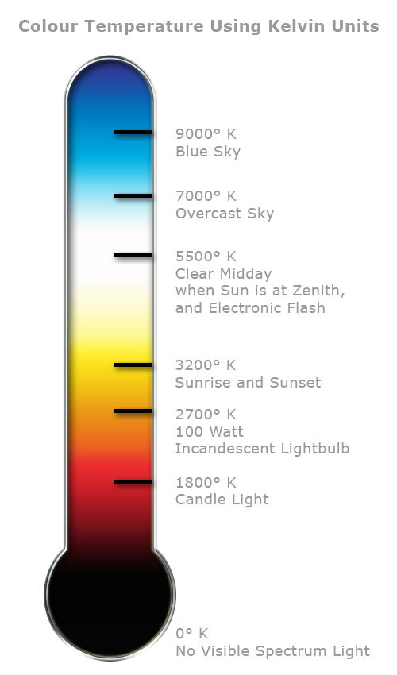

Preferred White Balance Block Diagram
RGB Gains
LUT
CT estimation (red norm)
Daylight
SET 4
Current
AWB
SET 1
CWF
SET 2
Incandescent
SET 3
Preferred WB
interpolation
engine
Horizon
SET 4
RGB GAINS

